Slide 1
Year 11 Information Evening Class of 2018

Slide 2
Summit (GCSEs)
Exam Timetable
May 2018
Superhero assembly
Easter Revision
Classes Schedule
Apr 2018
Enrichment day – Mr Beezy
(Exam Prep and motivation)
Exam Stress Workshop
Parental and staff postcards to
collate
Mar 2018
Year 11 Assemblies led by Core Subject HODs
Mock exam in English, Maths and Sci – Feb/Mar TBC
MAPPs (Monitoring Academic Progress Plan) taking place
with underachieving pupils in departments
Feb 2018
Ongoing Revision classes during and after school day
Jan 2018
Revision Reward Cards
Dec 2017
Parent Consultation Evening – mock exam results handed out
on this evening to pupils/parents/carers
Nov 2017
Base Camp (Now)
Mock exams/walk and talk mocks

Slide 3
Superheroes Assembly Parent/Carer Involvement
Parents/carers to write a personal message for their child to receive in the final assembly before the main exam period.
These will not be read out in the assembly. Pupils can open them in the assembly or read them at a later date away from friends and peers.
Deadline of collection: Friday 9th of February 2018
Main reception – Name of child and tutor group/Final Exam Assembly

Slide 4
For each card completed in full - £1.00 off yearbook
Tutors collecting cards and collating information on what revision sessions pupils are attending to direct students to classes which they are not attending.

Slide 5
What you can do as parents

Slide 6
Parental Roles
Project Manager
Agreeing the rules for homework/revision – consistency and a plan is vital
Helping your child to create a realistic homework/revision schedule
Help your child to organise a quiet work area at home for suitable study.
Helping your child to find a healthy work-life balance (plan breaks and social activities as well as revision
Ensuring your child gets enough sleep – a healthy mind = a healthy body.
Have key dates in your diary.

Slide 7
Parental Roles
Study Buddy
Showing an interest in your child’s work.
Helping with homework – not doing it for them.
Revise with them - buy them highlighters, cards, coloured pens, paper, folders, post it notes, revision guides and direct them to revision websites.
Testing their knowledge – let them teach you.
Agree times throughout homework/revision where you will check in with them to see how they are doing.
Get organised – stick copies of your child’s exam time table on the fridge/pinboard/your child’s bedroom wall, ensure your child has black pens, sharp pencils, rubber, ruler, compass, protractor, calculator, see through clear pencil case.

Slide 8
Parental Roles
Attendance Officer
Good Attendance and punctuality is intrinsically linked to success

Slide 9
Attendance
Good Attendance Means……..
Being in school at least 96% of the time.
365 days in the calendar year
175 Non School days a year!
All this time for shopping, holidays and appointments.
0 Days Absence
8 Days Absence
19 Days Absence
29 Days Absence
190
School
Days
In Each
Year
38 Days
Absence
47 Days
Absence
182
Days
of Education
171 Days of Education
161 Days
Of Education
152 Days of Education
143 Days
Of Education
100% attendance 96% attendance 90% attendance 85% attendance 80% attendance 75% attendance
Best Chances of Success Poor Attendance Very Poor Attendance
Less Chance of Success Serious impact on Education
‘Well done!’ ‘I’m Worried’ ‘I’m concerned reduces life chances’

Slide 10
Parental Roles
Supporter and Cheerleader
Your chief role will always be that of the person who cares most in the world, who is champion of their needs, admirer of every achievement and who will always be proud of them and love them, whatever happens.

Slide 11
@camshillks4
@GCSEtoolkit
@GCSErevision101
@GCSEpod
@RevisionTopTips
@examanxiety
www.kerboodle.com
Follow school departments on twitter for useful information

Slide 12
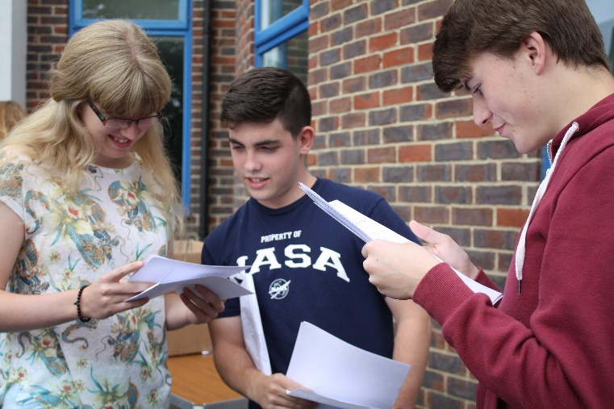
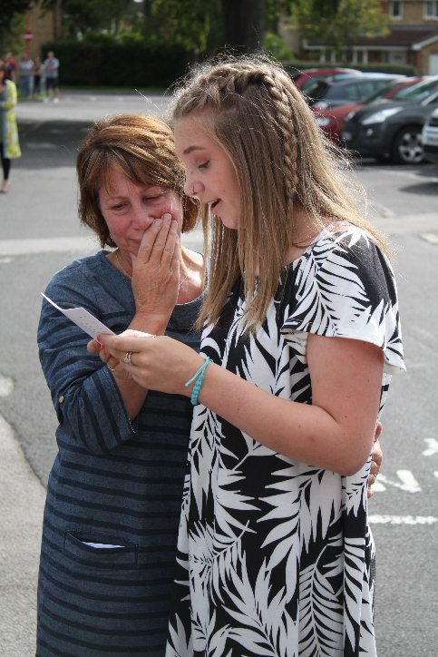
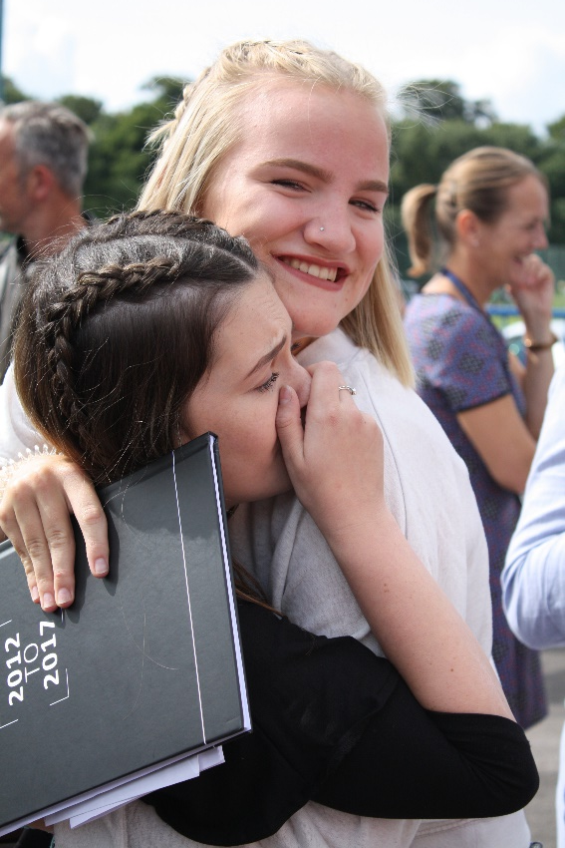
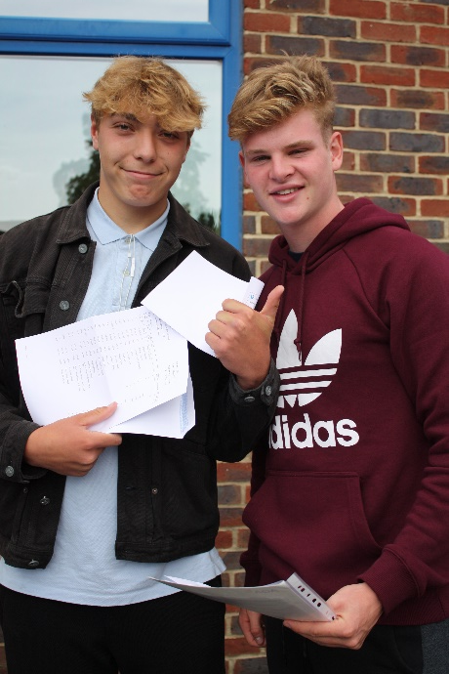
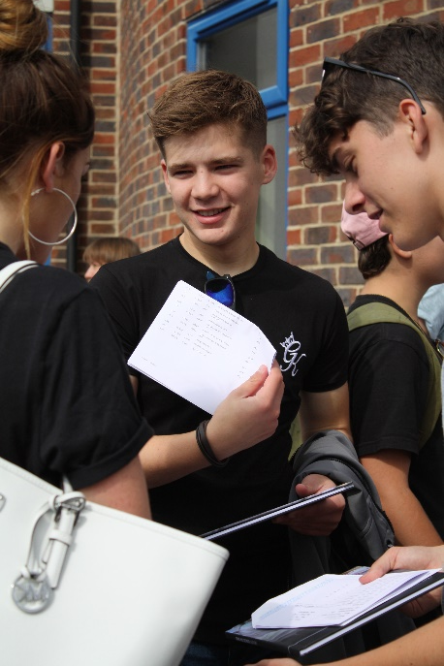
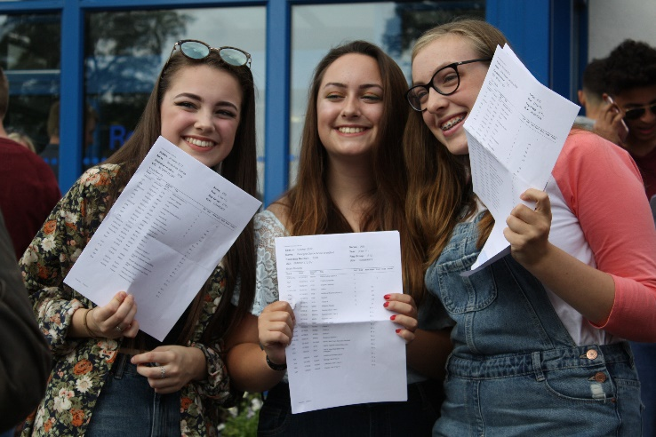
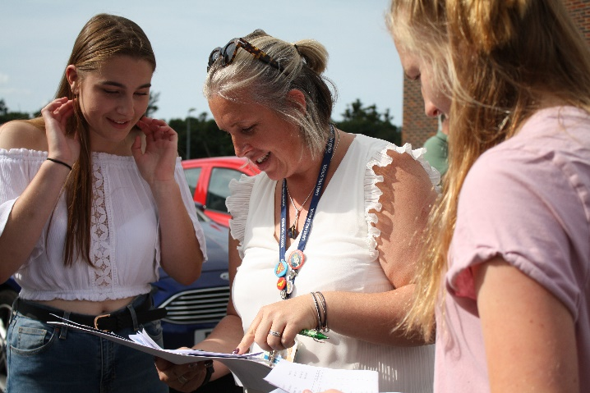
We wish your child every success in Year 11 2017-2018 at Cams Hill School

Slide 13
Supporting your child with English Language and English Literature at home

Slide 14
Paper 1: Explorations in creative reading and writing | Paper 2: Writers’ viewpoints and perspectives
How is it assessed? Written exam: 1 hour 45 minutes 80 Marks 50% of GCSE | How is it assessed? Written exam: 1 hour 45 minutes 80 marks 50% of GCSE
Section A: Reading 40 Marks (a combination of questions) One literature fiction text will be provided. The questions will be based on this text. Section B: Writing 40 Marks (extended writing question) You will be expected to write a piece of descriptive of narrative writing. | Section A: Reading 40 Marks (A combination of questions) You will be asked to answer questions based on two linked text. These will be: One non-fiction text One literary non-fiction text Section B: Writing 40 Marks (extended writing question) You will be asked to write to represent a viewpoint, e.g. a letter to argue a viewpoint on a given topic.
Non examination assessment: Speaking and listening This will test your ability to present, respond to questions and feedback and your use of Standard English

Slide 15
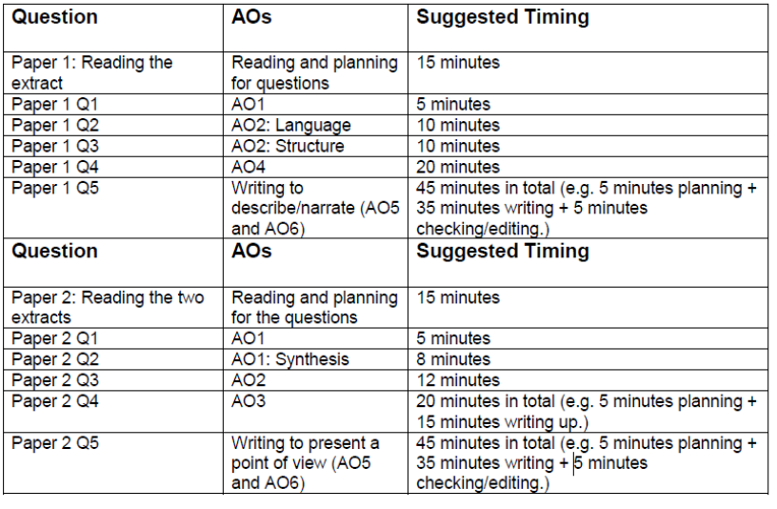

Slide 16
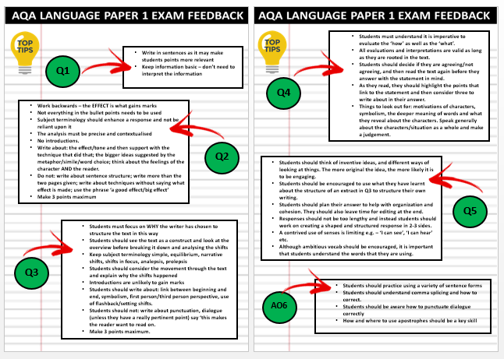
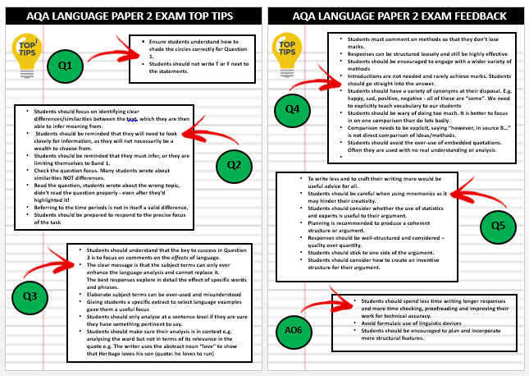

Slide 17
English Literature
A different qualification to the English Language qualification
Assessed again by 100 per cent examination. There is no controlled assessment for this qualification

Slide 18
Paper 1: Shakespeare and the 19th Century Novel | Paper 2: Modern Prose or Drama and Poetry
How is it assessed? Written exam: 1 hr 45 mins 64 Marks 40% of GCSE | How is it assessed? Written exam: 2 hour 15 minutes 96 marks 60% of GCSE
Questions Section A Shakespeare: One question on your play. Write in detail about an extract from the play and then write about the play as a whole. Section B The 19th-century novel: One question on your novel. Write in detail about an extract from the novel and then write about the novel as a whole. | Questions Section A Modern texts: One essay question from a choice of two on your studied modern prose or drama text. Section B Poetry: One comparative question on one named poem printed on the paper and one other poem from your chosen anthology cluster. Section C Unseen poetry: One question on one unseen poem and one question comparing this poem with a second unseen poem.
Macbeth
An Inspector Calls
Dr Jekyll and Mr Hyde
Poetry anthology

Slide 19
These texts are not about plot; the poems are not about simple themes. They are complex. They are about social divide, capitalism, exploitation, pride, ambition and so on…
All students have (or should have) an annotated copy of each of these texts (apart from the unseen poems, obviously). They need to be reading these every night.
Closed book exam. Pupils will need to know quotations from all of the texts.

Slide 20
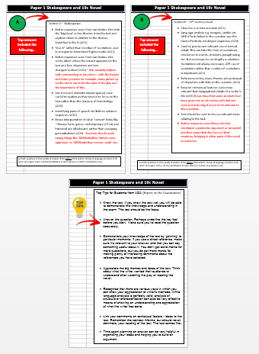
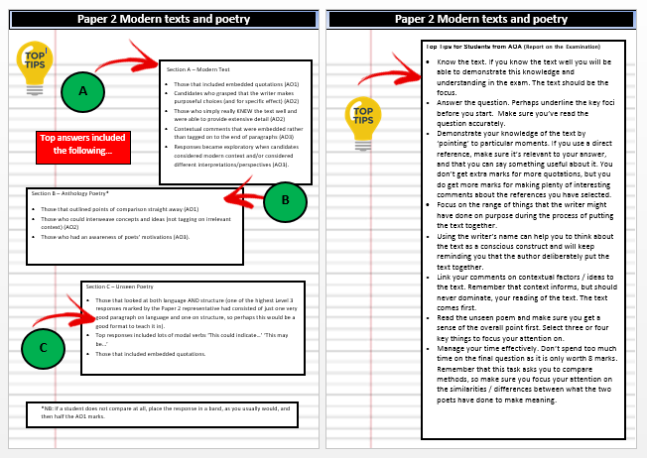

Slide 21
English Workshops
These workshops will be running every Monday for an hour after school.
The students are expected to bring along revision tools and the English teacher will provide support, along with past papers and practice questions.

Slide 22
How could you support your child?
Learn the Language content and the Literature texts and have meaningful discussion about it with your child
You might ask your child to ‘teach’ you the content. Verbalising it will help reinforce the content for them and you!
Look on the exam board website and download specimen papers
Ensure your child reads the literature texts every single night during the week. That might sound like a lot, but that really is the norm and expectation
Quiz your child, listen to the unabridged audiobooks, annotate the texts with them, ask them about meanings of words and phrases, ask them their opinion on certain non-fiction texts, ensure they are reading and commenting on a vast array of media
Encourage wider reading of fiction texts – this will help with creative writing task
Timing your child when undertaking a past paper

Slide 23
Supporting your child with Mathematics at home

Slide 24
Edexcel 1MA1
3 Papers (1.5 hours each)
P1 Non–Calculator Thursday 24/5/18 am
P2 Calculator Thursday 7/6/18 am
P3 Calculator Tuesday 12/6/18 am
80 marks per paper (240 marks in total)

Slide 25
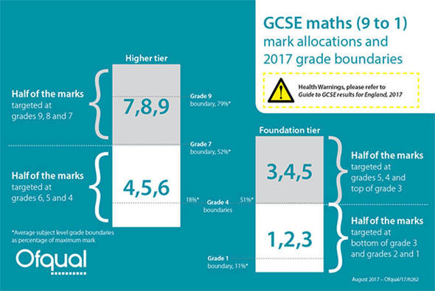

Slide 26
Key findings (examiners reports)
Arithmetic.
Illegibility.
Problem solving and reasoning.
Confidence in algebra.

Slide 27
What we offer
Year 11 Maths revision every Wednesday 3.15-4pm
Homework club Monday 3.15 – 4pm
Homework set weekly
Practice papers
WTM
Mocks

Slide 28
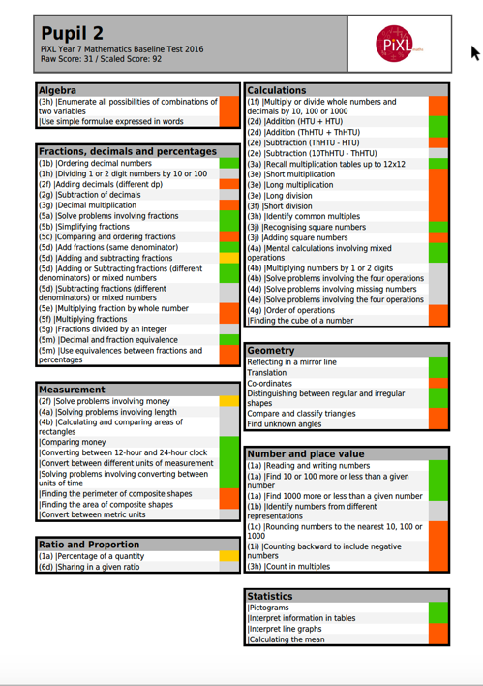
After mocks
‘Pixl Wave’
Current working grade
Predicted grade
PLC/ Smith pro forma

Slide 29
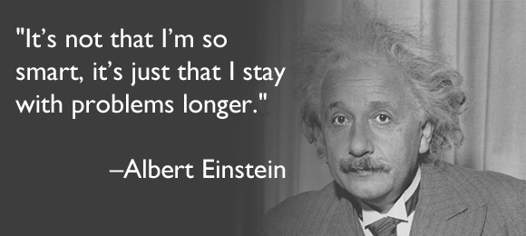
How to revise for Mathematics
Little and often.
Practise questions.
Focus on gaps in knowledge.

Slide 30
Websites
‘Mathswatch’
‘Pixl maths app’

Slide 31
